Slide 2
The Future of C# Return of the Jedi
B889
Dustin Campbell, Developer (@dcampbell)
Mads Torgersen, Program Manager (@MadsTorgersen)

Slide 3
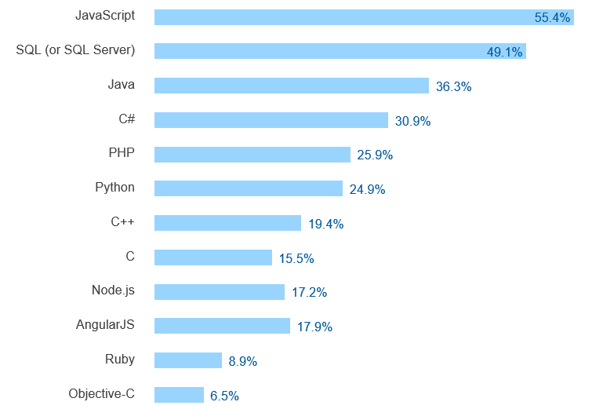

Most popular technologies
http://stackoverflow.com/research/developer-survey-2016#technology-most-popular-technologies

Slide 4
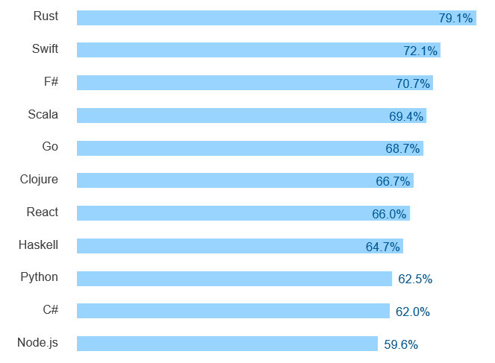
Most loved technologies
http://stackoverflow.com/research/developer-survey-2016#technology-most-loved-dreaded-and-wanted

Slide 5
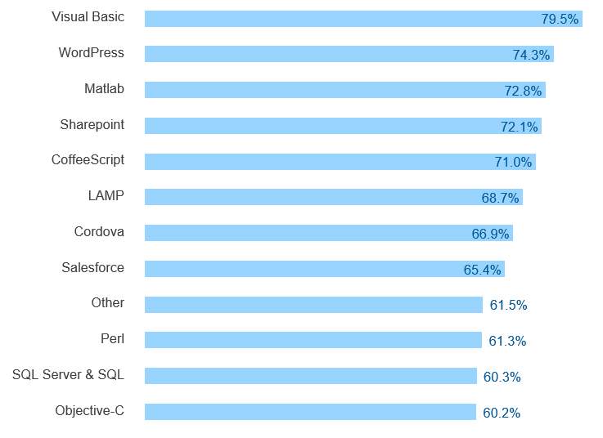
Most dreaded technologies
http://stackoverflow.com/research/developer-survey-2016#technology-most-loved-dreaded-and-wanted

Slide 6
Changing our tune…
Run on Windows
.NET as system component
Run on VM (CLR)
Black box compilers
Edit in Visual Studio
Proprietary
Run everywhere
Deploy with app
Compile to native
Open compiler APIs
Use your favorite editor
Open source

Slide 7
Roslyn
C# and VB language engine for all the things!
All the IDEs and editors
All the linters and analysis tools
All the fixing and refactoring and code generation tools
All the scripting and all the REPLs
There should only need to be
one code base in the world
for understanding C#

Slide 8
The Future of C#
C# 7
VS Code integration
Improving the “inner loop”

Slide 9
C# 7
Mads Torgersen

Slide 10
You saw…
Binary literals
Digit separators
Tuples
Pattern matching
Local functions
Ref returns and locals

Slide 11
Maybe: Records
class Person(string First, string Last);
class Person : IEquatable<Person>
{
public string First { get; }
public string Last { get; }
public Person(string First, string Last) { this.First = First; this.Last = Last; }
public (string First, string Last) Deconstruct() => (First, Last);
public bool Equals(Person other)
=> other != null && First == other.First && Last == other.Last;
public override bool Equals(object obj) => obj is Person other ? Equals(other) : false;
public override int GetHashCode() => GreatHashFunction(First, Last);
…
}

Slide 12
Maybe: Creating immutable objects
var p1 = new Point { X = 3, Y = 7 };
var p2 = p1 with { X = -p1.X };

Slide 13
VS Code Integration Improving the “Inner Loop”
Dustin Campbell

Slide 14
You saw…
C# IntelliSense and debugging in Visual Studio Code
Completion list filtering
Add Using improvements
Go to Implementation
New refactorings and fixes
Code Style
Source Generators

Slide 15

dotnetConf 2016
Immerse yourself in the world of .NET
Join us for 3 days of free online content, brought to you by the .NET Community and Microsoft product teams.
http://www.dotnetconf.net

Slide 16
Related Breakout Sessions
3/31 2:00pm - Cross-Platform Mobile with Xamarin, Miguel de Icaza
3/31 3:30pm - .NET Overview, Scott Hunter & Scott Hanselman
3/31 5:00pm - Introducing ASP.NET Core, Scott Hanselman
3/31 6:30pm - The Future of C#, Mads Torgersen & Dustin Campbell
4/1 9:00am - Entity Framework Core, Rowan Miller
4/1 10:30am - Building Desktop Apps in Visual Studio ’15’, Unni R.
4/1 12:30pm - ASP.NET Core Deep Dive into MVC, Dan Roth
4/1 2:00pm - Deploying ASP.NET Core Applications, Dan Roth
All Build sessions on demand on Channel 9.

Slide 17
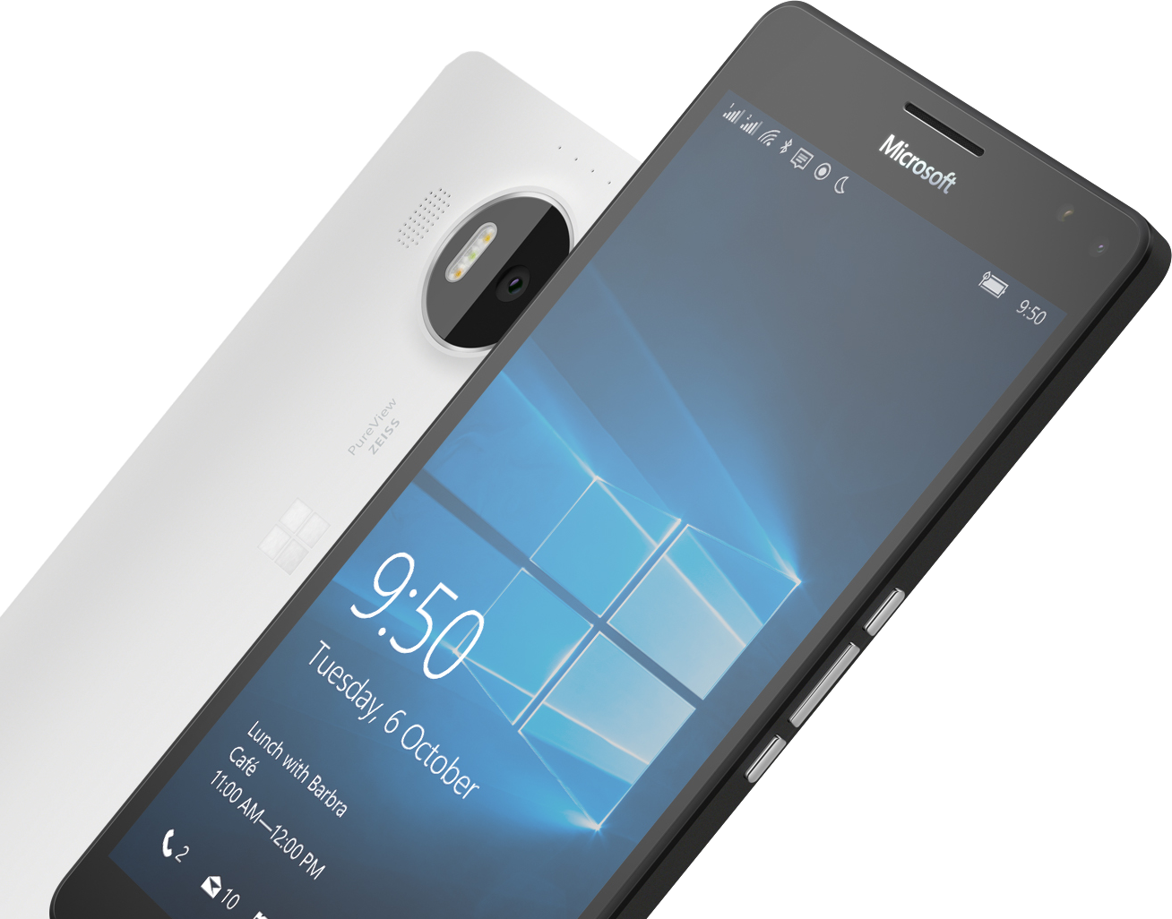
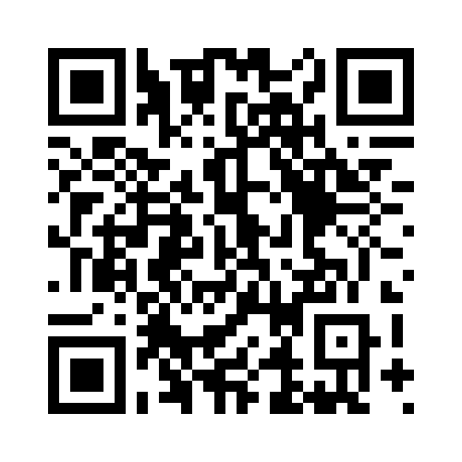

Please Complete An Evaluation Form Your input is important!
or

Slide 18
@dcampbell @MadsTorgersen

